Slide 1



Large Language Models
with Semantic Search
Introduction to Machine Learning for Engineers
Ing. Fabio Antonini
Software Engineer
Notes:
Welcome to this short course, Large Language Models with Semantic Search, built in partnership with Cohere.
In this course, you'll learn how to incorporate large language models, or LLMs, into information search in your own applications.
For example, let's say you run a website with a lot of articles, picture Wikipedia for the sake of argument, or a website with a lot of e-commerce products.
Even before LLMs, it was common to have keyword search to let people search your site. But with LLMs, you can now do much more.
First, you can let users ask questions that your system then searches your site or database to answer.
Second, the LLM makes the retrieved results more relevant to the meaning or the semantics of what the user is asking about.
This course consists of the following topics.
First, it shows you how to use basic keyword search, which is also called lexical search, and powered many search systems before large language models. It consists of finding the documents that have the highest number of matching words with the query.
Then you learn how to enhance this type of keyword search with a method called re-rank. As the name suggests, this ranks the responses by relevance to the query.
After this, you learn a more advanced method of search, which has vastly improved the results of keyword search, as it tries to use the actual meaning or semantic meaning of the text to carry out the search. This method is called dense retrieval.
This uses a very powerful tool in natural language processing called embeddings, which is a way to associate a vector of numbers with every piece of text.
Semantic search consists of finding the closest documents to the query in the space of embeddings.
Similar to other models, search algorithms need to be properly evaluated. You will also learn effective ways to do this.
Finally, since LLMs can be used to generate answers, you will learn how to plug the search results into an LLM and have it generate an answer based on them.
Dense retrieval with embeddings vastly improves the question-answering capabilities of an LLM, as it first searches for and retrieves the relevant documents and then creates an answer from this retrieved information.

Slide 2

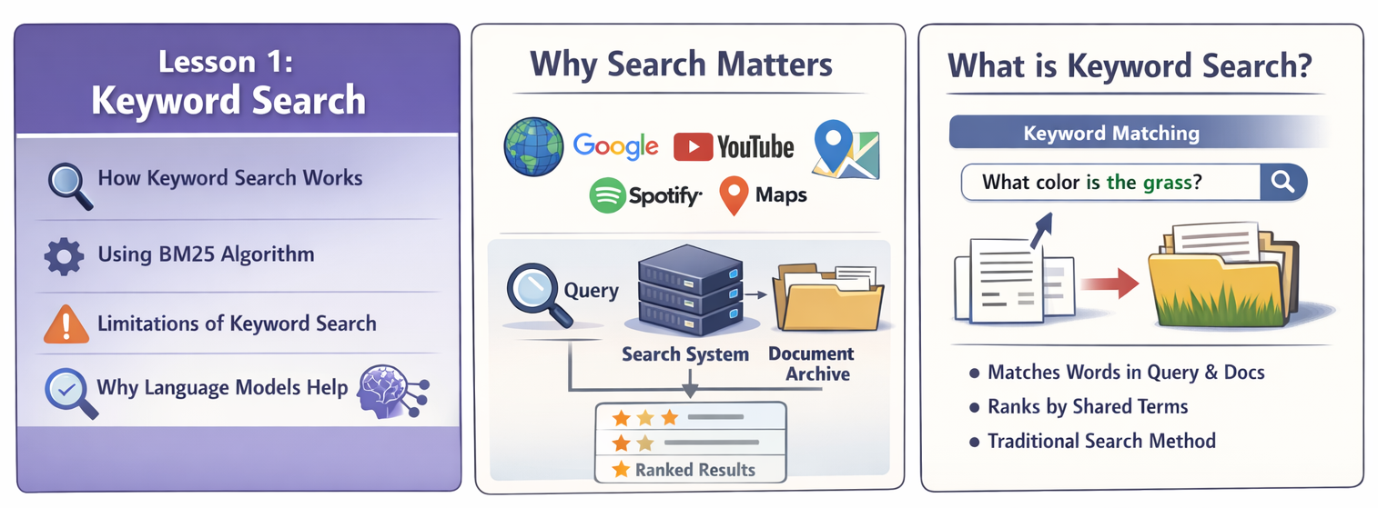
Keyword search (1/3)
What color is the grass?​
Tomorrow is Saturday.​
The grass is green.​
The capital of Canada is Ottawa.​
The sky is blue.​
A whale is a mammal.
Notes:
In this lesson, you will learn how to use keyword search to answer questions using a database.
Search is crucial to how we navigate the world. This includes search engines, but it also includes search within apps, such as when you search Spotify, YouTube, or Google Maps. Companies and organizations also need to use keyword search or other search methods to explore their internal documents.
Keyword search is the method most commonly used to build search systems. Let’s look at how we can use a keyword search system and then see how language models can improve it.
Let’s first understand keyword search conceptually.
Suppose the query is: What color is the grass?
Imagine a small archive with five sentences:
Tomorrow is Saturday.
The grass is green.
The capital of Canada is Ottawa.
The sky is blue.
A whale is a mammal.
Keyword search works by counting how many words are shared between the query and each document. For example, the first sentence only shares the word “is.” The second sentence shares more relevant words, so it would likely rank higher.
You can also inspect the dataset properties. Besides text and language, the database includes additional columns such as estimated page views. These can be used for filtering or sorting.
However, keyword search may retrieve documents that match only partially.

Slide 3
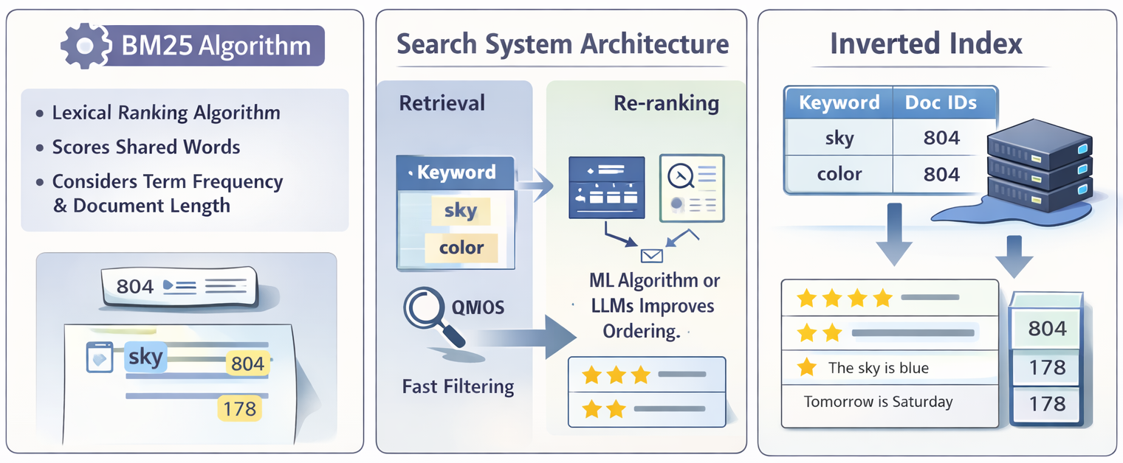

Keyword search (2/3)
Notes:
BM25 requires only one shared word to assign some relevance. The more shared words and repetitions, the higher the score.
However, we see that keyword search does not always return the most semantically relevant answer.
Let’s review search at a high level.
The major components are:
A query
A search system
A document archive
A ranked list of results
Search systems often operate in multiple stages.
The first stage is retrieval, typically using BM25 to score documents.
The second stage is re-ranking, which incorporates additional signals beyond simple text matching.
The retrieval stage often uses an inverted index.
An inverted index maps each keyword to the documents containing it. Instead of storing documents and scanning them sequentially, we store a table like:
Keyword → List of document IDs
This structure enables extremely fast search responses, often within milliseconds.
In practice, the inverted index also stores term frequency information, which helps compute relevance scores.
For example, for the query What color is the sky?, if both “color” and “sky” appear in document 804, that document will receive a high score.
Despite its efficiency, keyword search has limitations.
Consider the query: strong pain in the side of the head.
If the relevant document says sharp temple headache, keyword search may fail because the exact words do not match.

Slide 4
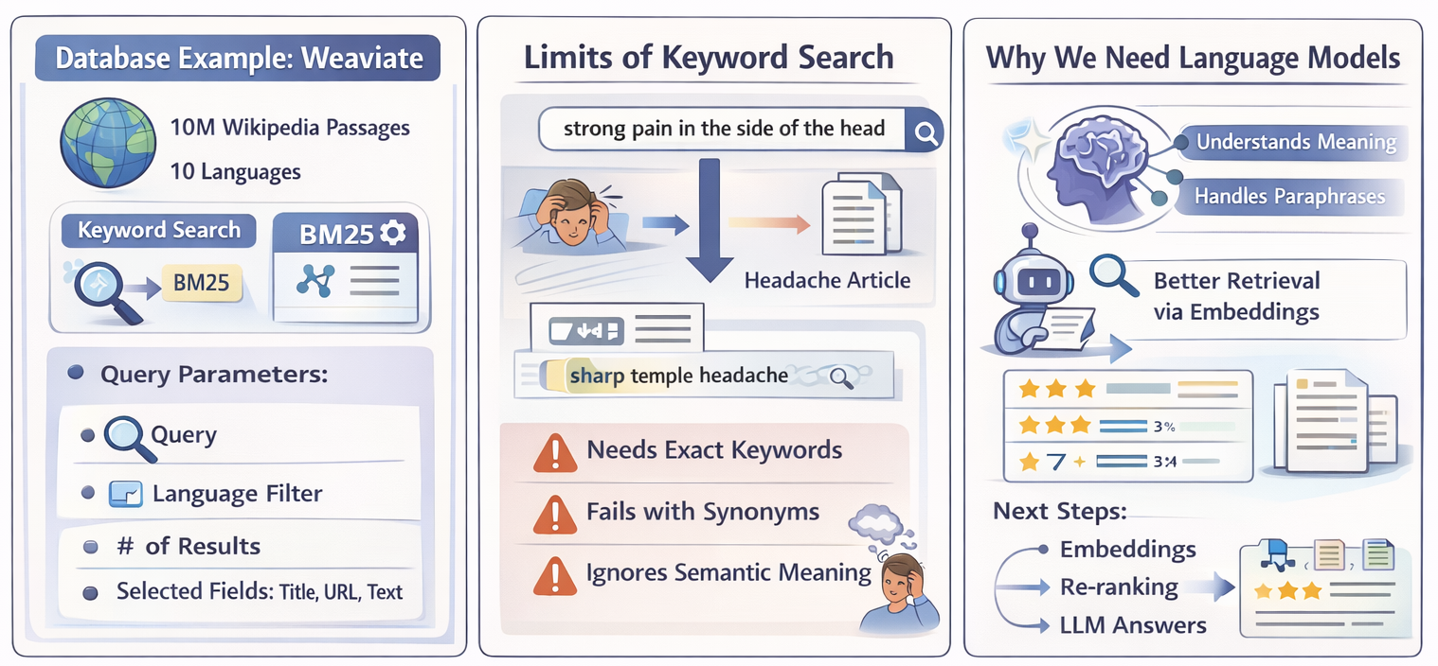
Keyword search (3/3)
Language models address this limitation by understanding semantic meaning rather than relying solely on keyword overlap.​
Notes:
Language models address this limitation by understanding semantic meaning rather than relying solely on keyword overlap.
They can improve both retrieval and re-ranking stages.
In the next lessons, we will explore how embeddings improve the retrieval stage and how re-ranking improves the second stage.
Finally, we will see how large language models can generate responses informed by search results retrieved beforehand.

Slide 5
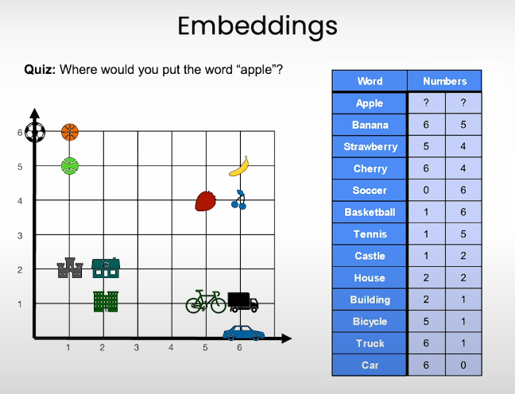
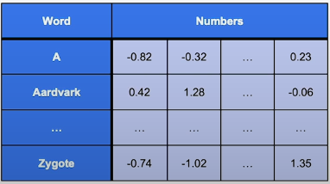
What Are Embeddings?
Definition
Numerical representations of text
Map words/sentences → vectors of numbers
Core component of Large Language Models
Key Idea
Similar meaning → similar vectors
Different meaning → distant vectors
Example
“Apple” placed near fruits
Words mapped to coordinates (vector space)
In practice: hundreds or thousands of dimensions
Notes:
Welcome to Lesson 2.
In this lesson you will learn about embeddings.
Embeddings are numerical representations of text that computers can more easily process. This makes them one of the most important components of large language models.
Let’s start with the embeddings lab.
This code helps us load all the API keys we need. In the classroom environment this is already done for you, but if you run it locally you would need to install some packages, for example the Cohere library.
For visualizations you would also install packages such as umap-learn, Altair, and datasets for loading the Wikipedia dataset.
Next, you import the Cohere library. This library provides many functions that use large language models through API calls. In this lesson we use the `embed` function, while other functions such as `generate` will be used later in the course.
The next step is to create a Cohere client using your API key.
Now, what is an embedding?
Imagine a grid with horizontal and vertical axes. Words are placed at different coordinates. Similar words are grouped together. For example:
* Sports in one region
* Buildings and houses in another
* Vehicles in another
* Fruits grouped together
The word “apple” would be placed among fruits. Its position might be represented by coordinates such as (5, 5).
An embedding maps each word to numbers representing its position in this space.
In practice, embeddings do not use just two numbers. They may use hundreds or even thousands of numbers to represent each word.
Next, we import pandas as `pd`, which helps us work with tables of data.
We create a small table with three words:
* joy
* happiness
* potato
We then generate embeddings for these words using the `embed` function.
The function requires:
* The dataset to embed
* The column containing the text
* The name of the embedding model
The result is a vector of numbers for each word.
For example, the vector for “joy” contains many numerical values.
Embeddings are not limited to single words. They also work for sentences and longer texts.
Consider two sentences:
* “Hello, how are you?”
* “Hi, how’s it going?”
They use different words but have similar meaning. Their embeddings will be close to each other in vector space.
We can create embeddings for a small dataset of sentences and visualize them.
In an example with eight sentences arranged in question-answer pairs, similar sentences appear close together in the embedding space.
Examples of pairs:
* “What color is the sky?” → “The sky is blue.”
* “What is an apple?” → “An apple is a fruit.”
* “Where does the bear live?” → “The bear lives in the woods.”
The closest sentence to a question is often its correct answer.
This idea forms the basis of dense retrieval:
Finding the closest vector in embedding space to answer a query.
Next, we apply embeddings to a larger dataset of 2,000 Wikipedia articles.
Each article contains:
* Title
* First paragraph
* Precomputed embedding
We reduce the high-dimensional embeddings to two dimensions for visualization.
When plotted, similar topics cluster together. For example:
* Languages appear near each other
* Countries cluster together
* Kings and queens cluster together
* Soccer players cluster together
* Artists cluster together
Embeddings organize text by semantic similarity.
In the next lesson, you will use embeddings to perform dense retrieval, meaning you will search for answers to queries in a large database by finding the closest embeddings.

Slide 6
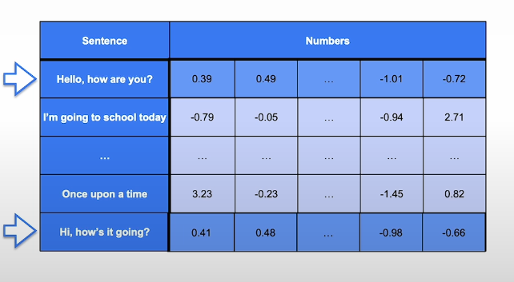
How Embeddings Work in Practice
Step 1: Generate Embeddings
Input: text column
Output: high-dimensional vector
Works for:
Single words
Sentences
Long documents
Important Property
“Hello, how are you?”
“Hi, how’s it going?” → Different words, similar vectors
Dimension Example
Sentence embedding length: 4096 numbers

Slide 7
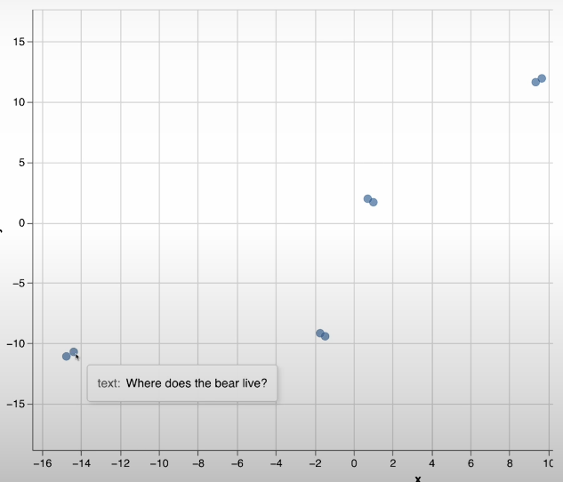
From Embeddings to Dense Retrieval
Visualization Insight
Similar sentences cluster together
Question-answer pairs are very close
Examples:
“What color is the sky?” ↔ “The sky is blue”
“What is an apple?” ↔ “An apple is a fruit”
Scaling to Large Datasets
2,000 Wikipedia articles
Similar topics cluster:
Languages
Countries
Kings & queens
Soccer players
Artists
Key Concept
Dense Retrieval = Find the closest vector to a query
Next Step
Use embeddings to search large databases semantically
Large Language Models with Semantic Search - DeepLearning.AI

Slide 8
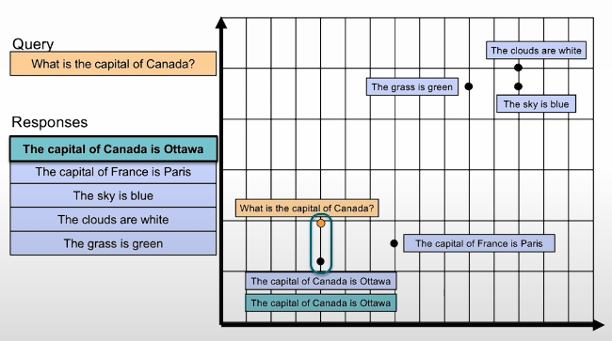
From Embeddings to Dense Retrieval
Goal: Use embeddings to perform semantic search (search by meaning).
Core Idea
Convert query → vector
Convert documents → vectors
Retrieve documents closest to the query in vector space
Key Principle
Similar meaning → small distance
Different meaning → large distance
Example Query: “What is the capital of Canada?” Closest vector → “The capital of Canada is Ottawa.”
This process is called Dense Retrieval.
Notes:
Welcome to Lesson 3 on Dense Retrieval. Now that we've learned about embeddings in the previous lesson, let's learn about how to use them for semantic search, or search by meaning. This lesson is going to be in two parts.
In the first part, we'll connect to the same database that we used in Lesson 1, but instead of doing keyword search, we will do vector search using the embeddings to perform semantic search.
Then, in the second part, after becoming comfortable with querying a vector database that's already been prepared for us, we will process the text from the beginning and see how we can build from scratch a vector index.
Let’s load our API keys using the same code from before. Before we do semantic search, we start by importing Cohere and setting up the Cohere Python SDK using the API key.
We also set up the Weaviate client and connect to the same database. Up to this point, nothing is new.
Before looking at the code for searching by embeddings for dense retrieval, let’s understand what it means conceptually.
Suppose we have the query:
“What is the capital of Canada?”
And we have several possible responses in our archive:
* The capital of Canada is Ottawa.
* The capital of France is Paris.
* Other unrelated sentences.
If we plot these in embedding space, sentences with similar meaning will be close to each other. Sentences about capitals cluster together, while sentences about colors cluster elsewhere.
If we project the query into that same embedding space using a search-optimized embedding model, it will be closest to the correct answer:
“The capital of Canada is Ottawa.”
This use of similarity and distance in embedding space for search is called **dense retrieval**, one of the two main approaches to semantic search (the other being re-rankers).
Now, let’s see how to do dense retrieval with Weaviate.
The main difference compared to keyword search (BM25) is that instead of using BM25, we use `nearText`, passing the query as a vector-based search parameter.
When we run queries like:
* “Who wrote Hamlet?”
The system matches embeddings and retrieves text most semantically similar to the query. The top result discusses Shakespeare writing Hamlet. We also receive a distance score indicating how close the result is to the query.
Comparing with keyword search:
* Keyword search might return pages about Canada (monarchy, flag, early period) but not the capital.
* Dense retrieval correctly returns the Ottawa page.
Another example:
* Query: “Tallest person in history”
* Keyword search returns irrelevant historical content.
* Dense retrieval correctly returns Robert Wadlow.
Dense retrieval also supports multilingual search. Using a multilingual embedding model, a query written in German or Arabic still retrieves the correct English result.
Dense retrieval is also powerful for exploration. For example:
* “Film about a time travel paradox”
returns relevant films like *About Time* or *The Time Machine*.
That concludes Part 1: consuming an existing vector database.
---
### Part 2: Building a Vector Search Database
We now build our own vector search system from scratch.
We import:
* Annoy (Approximate Nearest Neighbor library)
* Standard Python libraries
Using text from a Wikipedia page (e.g., Interstellar), we copy the text and store it in a variable.
A key design question is **chunking**:
* Split by sentences?
* Split by paragraphs?
* Or other strategy?
There is no universal answer. Generally:
* Each chunk should contain one coherent idea.
* Chunking depends on the use case.
* Noisy text may require more advanced sentence splitting.
If we split by sentences, some sentences may lack context.
For example:
“It received acclaim for its performance…”
Without context, the embedding may not know what “it” refers to.
A solution:
* Append the page title (e.g., “Interstellar”) to each chunk.
* This gives additional context before embedding.
Once we decide on chunking:
* Each chunk is embedded into a vector (e.g., 4000+ dimensions).
* We store these vectors in an index.
Using Annoy:
* Create an index.
* Insert vectors.
* Build and save the index.
To search:
1. Embed the query.
2. Send query embedding to the vector index.
3. Retrieve the nearest neighbors.
4. Return top results with similarity scores.
Example:
Query: “How much did the film make?”
The system retrieves:
“The film had a worldwide gross of over $677 million.”
---
### Approximate Nearest Neighbors vs Vector Databases
Dense retrieval finds nearest neighbors in embedding space.
To optimize speed, we use **Approximate Nearest Neighbor (ANN)** algorithms:
* Annoy (Spotify)
* FAISS (Facebook)
* ScaNN (Google)
Vector databases (e.g., Weaviate, Pinecone, Qdrant, Vespa, Chroma):
* Store both vectors and text
* Allow filtering and advanced queries
* Easier to update without rebuilding index
* More feature-rich
ANN libraries:
* Simpler setup
* Store vectors only
* Require rebuilding index to update
Vector databases:
* Handle updates
* Provide filtering
* Manage metadata
* Return text directly
---
### Hybrid Search
In practice, keyword search and vector search complement each other.
Hybrid search:
* Run keyword search and vector search in parallel
* Combine scores
* Possibly add additional ranking signals (e.g., PageRank)
Search engines use many ranking signals beyond text similarity.
---
In the next lesson, you will learn about **re-ranking**, the second main method of semantic search, and how it improves ranking quality.

Slide 9
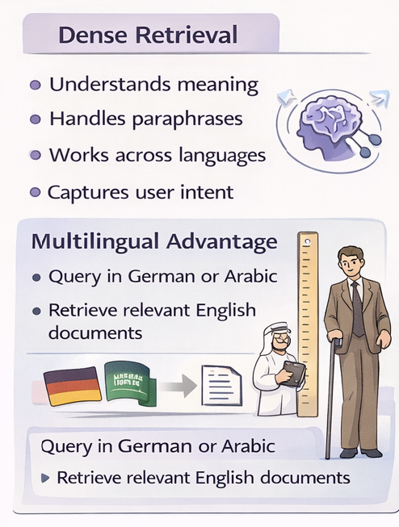
Why Dense Retrieval Works Better Than Keyword Search
Keyword Search
Matches exact words
May return partially related results
Struggles with paraphrasing
Dense Retrieval
Understands meaning
Handles paraphrases
Works across languages
Captures user intent
Example Query: “Tallest person in history” → Returns Robert Wadlow (correct result) Even if the exact phrase isn’t used.
Multilingual Advantage
Query in German or Arabic
Retrieve relevant English documents

Slide 10
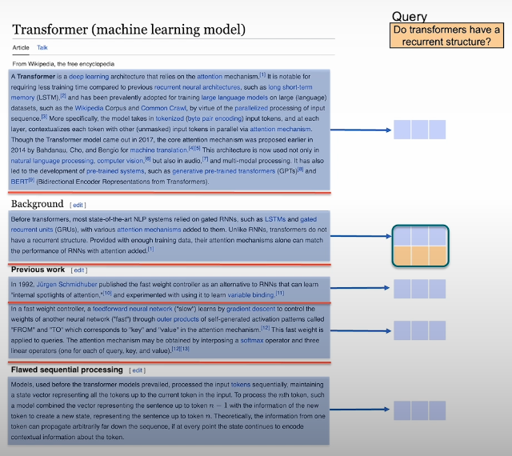
Building a Semantic Search System
To build a dense retrieval system:
1. Chunk the Text
Split documents into meaningful pieces
Sentence-level or paragraph-level
Each chunk should contain one idea
2. Add Context (When Needed)
Avoid context-free fragments
Enrich chunks with titles or metadata
3. Embed Everything
Convert each chunk into a vector
4. Search by Similarity
Embed the query
Find nearest vectors
Return most relevant chunks
Search = Nearest Neighbor in Embedding Space

Slide 11
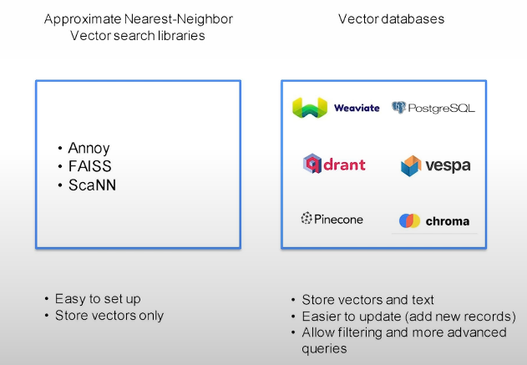
ANN Libraries vs Vector Databases & Hybrid Search
Approximate Nearest Neighbor (ANN) Libraries
Fast similarity search
Store vectors only
Simple setup
Require rebuilding index for updates
Examples:
Annoy
FAISS
ScaNN
Vector Databases
Store vectors + metadata + text
Support filtering and updates
More feature-rich
Examples:
Weaviate
Pinecone
Qdrant
Chroma
Hybrid Search (Real-World Systems)​
Best practice:​
Combine keyword search + vector search​
Aggregate scores​
Add external ranking signals (e.g., authority, popularity)​
Modern search engines use many ranking signals, not just text similarity.​

Slide 12
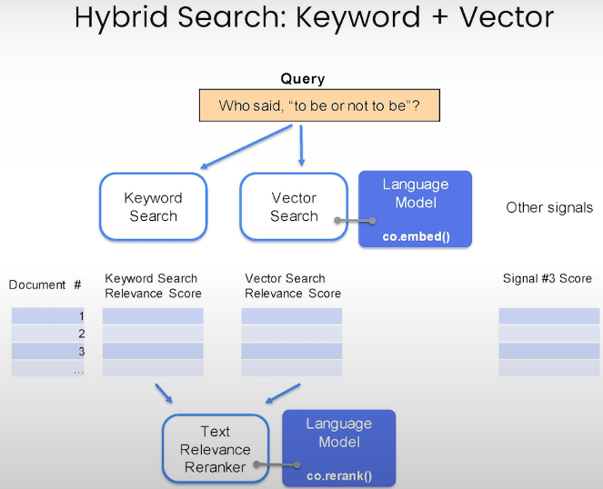
Hybrid Search (Real-World Systems)
Best practice:​
Combine keyword search + vector search​
Aggregate scores​
Add external ranking signals (e.g., authority, popularity)​
Modern search engines use many ranking signals, not just text similarity.​

Slide 13
What Is Rerank?
Rerank = Ranking by Relevance
Rerank is the second core component of semantic
search (after dense retrieval).
It:
Takes a query
Takes a set of candidate results
Assigns a relevance score
Sorts results from best to worst
Why Do We Need It?
Dense retrieval finds the most similar sentences. But similarity ≠ correctness.
Rerank helps identify:
The most relevant
The most precise
The most correct answer
Notes:
Welcome to Lesson 4. I am very excited to show you one of my favorite methods called **Rerank**.
Now that you've learned keyword search and dense retrieval, Rerank is a way to improve them both. It is actually the second component of semantic search, in addition to dense retrieval.
Rerank allows a large language model to sort search results from best to worst based on how relevant they are to a given query.
---
### Rerank in Action
We begin by performing a search using Dense Retrieval, as learned in the previous lesson.
For example, consider the query:
**“What is the capital of Canada?”**
Dense retrieval may return:
* Ottawa (correct)
* Toronto
* Quebec City
Why does this happen?
Dense retrieval retrieves the most semantically similar sentences to the query. However, similarity does not always mean correctness. A sentence may be very close in meaning but still not answer the question correctly.
For example, possible responses could include:
* The capital of Canada is Ottawa. (Correct)
* Toronto is in Canada. (True but irrelevant)
* The capital of France is Paris. (True but wrong country)
* The capital of Canada is Sydney. (False)
* The capital of Ontario is Toronto. (True but wrong level)
Dense retrieval selects the sentences that are closest in embedding space. But the closest one might not be the correct answer.
This is where **Rerank** comes into play.
---
### What Rerank Does
Rerank takes:
* A query
* A set of candidate responses (from keyword search or dense retrieval)
It assigns a **relevance score** to each query-response pair.
The response with the highest relevance score is considered the best match.
For example:
* “The capital of Canada is Ottawa.” → Relevance: 0.90
* Other candidates → Lower scores
Rerank is trained using:
* Positive query-response pairs (correct matches)
* Negative query-response pairs (incorrect matches)
It learns to assign:
* High scores to correct matches
* Low scores to irrelevant or incorrect matches
---
### Improving Keyword Search with Rerank
Keyword search may retrieve many documents that contain similar words but do not answer the question.
If we retrieve many keyword results (for example, 500 documents), Rerank can:
* Evaluate each document
* Score them by relevance
* Select the top-ranked answers
This allows us to recover the correct answer even when keyword search alone fails.
---
### Improving Dense Retrieval with Rerank
Consider the query:
**“Who is the tallest person in history?”**
Dense retrieval may already retrieve relevant documents (e.g., Robert Wadlow).
But Rerank can:
* Score the candidates
* Ensure the most correct and precise answer appears at the top
For example:
* Robert Wadlow → Relevance: 0.97
* Other related articles → Lower scores
Rerank refines and improves the output of dense retrieval.
---
### Evaluating Search Systems
Search systems can be evaluated using metrics such as:
* **Mean Average Precision (MAP)**
* **Mean Reciprocal Rank (MRR)**
* **Normalized Discounted Cumulative Gain (NDCG)**
To evaluate:
* Create a test set with queries and correct answers
* Compare system outputs to ground truth
* Compute ranking-based metrics
---
### What’s Next?
Now that you know how to:
* Retrieve documents (keyword search + dense retrieval)
* Improve ranking with Rerank
The next step is to combine:
* A search system
* A generation model
This allows the system to generate natural language answers, like a human would.
---

Slide 14
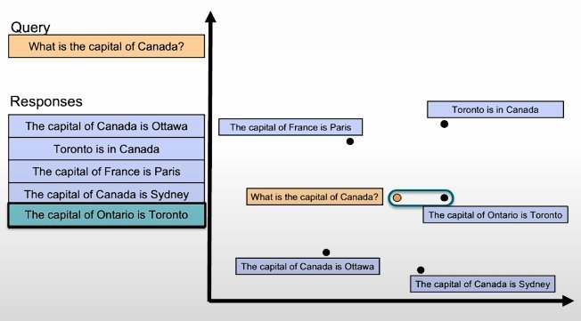
The Problem with Dense Retrieval Alone
Example Query: “What is the capital of Canada?”
Dense retrieval may return:
The capital of Canada is Ottawa ✅
Toronto is in Canada
The capital of Ontario is Toronto
The capital of France is Paris
Why?
Dense retrieval selects sentences that are:
Semantically close
But not necessarily answering the question
It retrieves similar content, not guaranteed answers.
Notes:
Welcome to Lesson 4. I am very excited to show you one of my favorite methods called **Rerank**.
Now that you've learned keyword search and dense retrieval, Rerank is a way to improve them both. It is actually the second component of semantic search, in addition to dense retrieval.
Rerank allows a large language model to sort search results from best to worst based on how relevant they are to a given query.
---
### Rerank in Action
We begin by performing a search using Dense Retrieval, as learned in the previous lesson.
For example, consider the query:
**“What is the capital of Canada?”**
Dense retrieval may return:
* Ottawa (correct)
* Toronto
* Quebec City
Why does this happen?
Dense retrieval retrieves the most semantically similar sentences to the query. However, similarity does not always mean correctness. A sentence may be very close in meaning but still not answer the question correctly.
For example, possible responses could include:
* The capital of Canada is Ottawa. (Correct)
* Toronto is in Canada. (True but irrelevant)
* The capital of France is Paris. (True but wrong country)
* The capital of Canada is Sydney. (False)
* The capital of Ontario is Toronto. (True but wrong level)
Dense retrieval selects the sentences that are closest in embedding space. But the closest one might not be the correct answer.
This is where **Rerank** comes into play.
---
### What Rerank Does
Rerank takes:
* A query
* A set of candidate responses (from keyword search or dense retrieval)
It assigns a **relevance score** to each query-response pair.
The response with the highest relevance score is considered the best match.
For example:
* “The capital of Canada is Ottawa.” → Relevance: 0.90
* Other candidates → Lower scores
Rerank is trained using:
* Positive query-response pairs (correct matches)
* Negative query-response pairs (incorrect matches)
It learns to assign:
* High scores to correct matches
* Low scores to irrelevant or incorrect matches
---
### Improving Keyword Search with Rerank
Keyword search may retrieve many documents that contain similar words but do not answer the question.
If we retrieve many keyword results (for example, 500 documents), Rerank can:
* Evaluate each document
* Score them by relevance
* Select the top-ranked answers
This allows us to recover the correct answer even when keyword search alone fails.
---
### Improving Dense Retrieval with Rerank
Consider the query:
**“Who is the tallest person in history?”**
Dense retrieval may already retrieve relevant documents (e.g., Robert Wadlow).
But Rerank can:
* Score the candidates
* Ensure the most correct and precise answer appears at the top
For example:
* Robert Wadlow → Relevance: 0.97
* Other related articles → Lower scores
Rerank refines and improves the output of dense retrieval.
---
### Evaluating Search Systems
Search systems can be evaluated using metrics such as:
* **Mean Average Precision (MAP)**
* **Mean Reciprocal Rank (MRR)**
* **Normalized Discounted Cumulative Gain (NDCG)**
To evaluate:
* Create a test set with queries and correct answers
* Compare system outputs to ground truth
* Compute ranking-based metrics
---
### What’s Next?
Now that you know how to:
* Retrieve documents (keyword search + dense retrieval)
* Improve ranking with Rerank
The next step is to combine:
* A search system
* A generation model
This allows the system to generate natural language answers, like a human would.
---

Slide 15
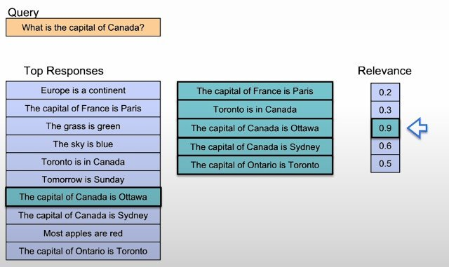
How Rerank Solves the Problem
Step 1
Search system retrieves top N candidates (keyword search or dense retrieval)
Step 2
Rerank evaluates each query–document pair
Step 3
Assign relevance score:
High score → Correct & relevant
Low score → Irrelevant or misleading
Example:
“The capital of Canada is Ottawa” → 0.98
Other candidates → lower scores
Final result: Correct answer ranked at the top.
Notes:
Welcome to Lesson 4. I am very excited to show you one of my favorite methods called **Rerank**.
Now that you've learned keyword search and dense retrieval, Rerank is a way to improve them both. It is actually the second component of semantic search, in addition to dense retrieval.
Rerank allows a large language model to sort search results from best to worst based on how relevant they are to a given query.
---
### Rerank in Action
We begin by performing a search using Dense Retrieval, as learned in the previous lesson.
For example, consider the query:
**“What is the capital of Canada?”**
Dense retrieval may return:
* Ottawa (correct)
* Toronto
* Quebec City
Why does this happen?
Dense retrieval retrieves the most semantically similar sentences to the query. However, similarity does not always mean correctness. A sentence may be very close in meaning but still not answer the question correctly.
For example, possible responses could include:
* The capital of Canada is Ottawa. (Correct)
* Toronto is in Canada. (True but irrelevant)
* The capital of France is Paris. (True but wrong country)
* The capital of Canada is Sydney. (False)
* The capital of Ontario is Toronto. (True but wrong level)
Dense retrieval selects the sentences that are closest in embedding space. But the closest one might not be the correct answer.
This is where **Rerank** comes into play.
---
### What Rerank Does
Rerank takes:
* A query
* A set of candidate responses (from keyword search or dense retrieval)
It assigns a **relevance score** to each query-response pair.
The response with the highest relevance score is considered the best match.
For example:
* “The capital of Canada is Ottawa.” → Relevance: 0.90
* Other candidates → Lower scores
Rerank is trained using:
* Positive query-response pairs (correct matches)
* Negative query-response pairs (incorrect matches)
It learns to assign:
* High scores to correct matches
* Low scores to irrelevant or incorrect matches
---
### Improving Keyword Search with Rerank
Keyword search may retrieve many documents that contain similar words but do not answer the question.
If we retrieve many keyword results (for example, 500 documents), Rerank can:
* Evaluate each document
* Score them by relevance
* Select the top-ranked answers
This allows us to recover the correct answer even when keyword search alone fails.
---
### Improving Dense Retrieval with Rerank
Consider the query:
**“Who is the tallest person in history?”**
Dense retrieval may already retrieve relevant documents (e.g., Robert Wadlow).
But Rerank can:
* Score the candidates
* Ensure the most correct and precise answer appears at the top
For example:
* Robert Wadlow → Relevance: 0.97
* Other related articles → Lower scores
Rerank refines and improves the output of dense retrieval.
---
### Evaluating Search Systems
Search systems can be evaluated using metrics such as:
* **Mean Average Precision (MAP)**
* **Mean Reciprocal Rank (MRR)**
* **Normalized Discounted Cumulative Gain (NDCG)**
To evaluate:
* Create a test set with queries and correct answers
* Compare system outputs to ground truth
* Compute ranking-based metrics
---
### What’s Next?
Now that you know how to:
* Retrieve documents (keyword search + dense retrieval)
* Improve ranking with Rerank
The next step is to combine:
* A search system
* A generation model
This allows the system to generate natural language answers, like a human would.
---

Slide 16
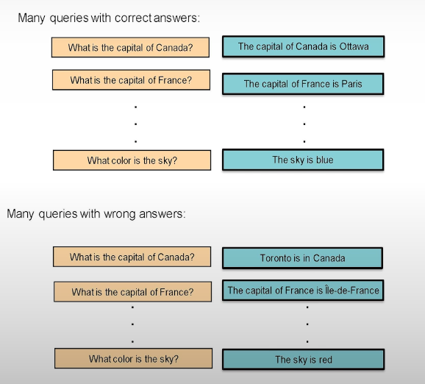
How Rerank Models Are Trained
Here is the slide in the same clean format used before:
How Rerank Models Are Trained
🎯 Goal
Learn to assign a relevance score to a (query, document) pair.
📚 Training Data
Positive pairs → high relevance
Negative pairs → low relevance
Example: Query: “What is the capital of Canada?”
Ottawa → high score
Paris / Toronto → low score
🧠 What the Model Learns
Distinguish correct answers from merely similar ones
Rank candidate results from best to worst
📊 Output
A relevance score between 0 and 1 Higher score → more relevant to the query
Notes:
Welcome to Lesson 4. I am very excited to show you one of my favorite methods called **Rerank**.
Now that you've learned keyword search and dense retrieval, Rerank is a way to improve them both. It is actually the second component of semantic search, in addition to dense retrieval.
Rerank allows a large language model to sort search results from best to worst based on how relevant they are to a given query.
---
### Rerank in Action
We begin by performing a search using Dense Retrieval, as learned in the previous lesson.
For example, consider the query:
**“What is the capital of Canada?”**
Dense retrieval may return:
* Ottawa (correct)
* Toronto
* Quebec City
Why does this happen?
Dense retrieval retrieves the most semantically similar sentences to the query. However, similarity does not always mean correctness. A sentence may be very close in meaning but still not answer the question correctly.
For example, possible responses could include:
* The capital of Canada is Ottawa. (Correct)
* Toronto is in Canada. (True but irrelevant)
* The capital of France is Paris. (True but wrong country)
* The capital of Canada is Sydney. (False)
* The capital of Ontario is Toronto. (True but wrong level)
Dense retrieval selects the sentences that are closest in embedding space. But the closest one might not be the correct answer.
This is where **Rerank** comes into play.
---
### What Rerank Does
Rerank takes:
* A query
* A set of candidate responses (from keyword search or dense retrieval)
It assigns a **relevance score** to each query-response pair.
The response with the highest relevance score is considered the best match.
For example:
* “The capital of Canada is Ottawa.” → Relevance: 0.90
* Other candidates → Lower scores
Rerank is trained using:
* Positive query-response pairs (correct matches)
* Negative query-response pairs (incorrect matches)
It learns to assign:
* High scores to correct matches
* Low scores to irrelevant or incorrect matches
---
### Improving Keyword Search with Rerank
Keyword search may retrieve many documents that contain similar words but do not answer the question.
If we retrieve many keyword results (for example, 500 documents), Rerank can:
* Evaluate each document
* Score them by relevance
* Select the top-ranked answers
This allows us to recover the correct answer even when keyword search alone fails.
---
### Improving Dense Retrieval with Rerank
Consider the query:
**“Who is the tallest person in history?”**
Dense retrieval may already retrieve relevant documents (e.g., Robert Wadlow).
But Rerank can:
* Score the candidates
* Ensure the most correct and precise answer appears at the top
For example:
* Robert Wadlow → Relevance: 0.97
* Other related articles → Lower scores
Rerank refines and improves the output of dense retrieval.
---
### Evaluating Search Systems
Search systems can be evaluated using metrics such as:
* **Mean Average Precision (MAP)**
* **Mean Reciprocal Rank (MRR)**
* **Normalized Discounted Cumulative Gain (NDCG)**
To evaluate:
* Create a test set with queries and correct answers
* Compare system outputs to ground truth
* Compute ranking-based metrics
---
### What’s Next?
Now that you know how to:
* Retrieve documents (keyword search + dense retrieval)
* Improve ranking with Rerank
The next step is to combine:
* A search system
* A generation model
This allows the system to generate natural language answers, like a human would.
---

Slide 17
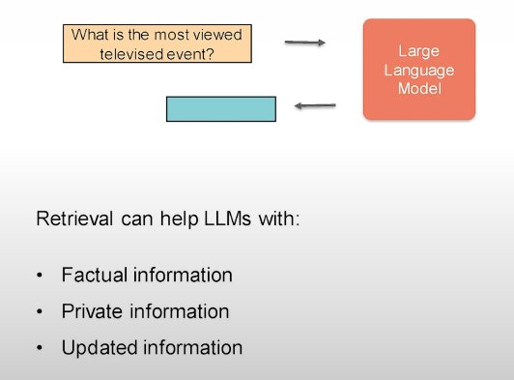
From Search to Generation
🎯 Goal
Move from returning search results to generating structured answers.
Traditional Pipeline
Query → Search → List of documents
Enhanced Pipeline
Query → Search → Context → LLM → Generated Answer
Why Add Generation?
Users want answers, not documents
Enables “chat with your data”
Makes interaction more natural
Notes:
In this lesson, we'll add a generation step using
an LLM at the end of the search pipeline.
This way, we can get an answer instead of search results,
for example.
This is a cool method to build apps where a user can
chat with a document or a book, or, as we'll see in this lesson, an
article.
Large language models are great at many things. There are,
however, use cases where they require some help.
Let's take an example.
So let's say you have a question that is.
Are side projects important when you are starting
to learn about AI?
You can ask this to a large language model.
Some of them might give you interesting answers
but what is more interesting really is if
you ask an expert or the writings of an expert.
An example here is if you can ask this to
Andrew Ang or consult some of Andrew's
writings about a question like this.
Luckily, we have access to some of Andrew's
writings.
So you can go in Deep Learning AI.
There's this newsletter called The Batch, and
you can find this series of articles called.
How to Build a Career in AI.
It's in multiple articles.
We'll use what we've learned in this course to search and then generate an
answer from this article using a
generative large-language model.
Let's visualize this and describe exactly what we mean.
We can ask a large-language model a question, and they're able
to answer many questions.
But sometimes we want them to answer from
a specific document or archive.
This is where you can add a search component
before the generation step to improve those generations.
When you rely on a large-language model's direct answer, you're relying on
the world information it has stored inside of
it.
But you can provide it with context using
a search step beforehand, for example.
When you provide it to the context in the prompt,
that leads to better generations for cases when
you want to anchor the model to a specific domain or article
or document or our text archive in general.
This also improves factual generations.
So, in a lot of cases where you want facts to
be retrieved from the model, and you augment it
with a context like this, that improves the
probability of the model being more factual in its generation.
The difference between the two steps is, instead of just asking
the question to a generative model and seeing
the result that it prints out, we can first present the
question to a search system, exactly like the ones we
built earlier in this course.
Then we retrieve some of these results, we pose them in the prompt
to the generative model in addition to the question and then we
get that response that was informed by the context.
We'll look at exactly how to do that in the code example next.
So this is our question.
Let's build our text archive.
For this use case we'll simply just open these articles
and copy the text.
We can just copy it and paste it in this
variable we can call text.
Just dump all of them in there.
We can copy three, so this is the second article.
And here we have a variable that contains
the text of three articles.
You can do more.
The series is a great read.
And it's, I think, maybe in seven or eight parts, but
we can do this example with three. Some familiar code that you've seen
in the past to set up the environment we run here.
Also some more familiar code so we can import co here,
because next we will be embedding this text.
We'll be chunking it first and then embedding it
and then building our semantic search index.
So this is where we've chunked it.
Let's look at what text looks like now.
Now, let's look at the first three examples.
So these are the first three chunks.
So the rapid rise of AI has led to a rapid rise in AI jobs.
Three key steps for career growth initially.
So these are three passages, three paragraphs from Andrew's
article.
Next, we can proceed to setting up the Cohere
SDK and embedding the texts.
So here, we're sending it to embed and getting the embeddings back.
Now, let's build our text archive.
We do a few imports.
We've seen all of these before.
So this is Annoy, which is the vector search library.
NumPy, Pandas will not be using regular expressions,
but it's always good to have them handy when dealing
with texts in general.
So the same code goes here, and to run through this is we're
just turning it into a NumPy array.
So these are the vectors that we got back.
So these are the embeddings.
We create a new index, a vector index.
We insert the vectors into it and then we build
it and save it to file.
Now we have our vector search.
Let's now define a function. Let's call this one search Andrew's article.
And we give it a query and it will run
a search on this data set.
And to do that, these steps are exactly what we've
seen in the past, so we embed the query, we
do a vector search of the archive, so we compare the query
versus the embedding of every paragraph in the text, and
then we return the result.
Now we can ask this search system a question, kind of like this,
are side projects a good idea when trying
to build a career in AI?
So I wonder what Andrew would say about this.
And here we return the first result.
So this is a long paragraph, and it's the closest match to this question.
And if you look somewhere here, develop a side hustle,
even if you have a full-time job.
A fun project that may or not develop
into something bigger can stir the creative juices.
So that's the answer way in the center of this big text here.
This is a great case for why we can use
a large language model to answer this. So we can give
it this and we have it extract that relevant piece of information
for us.
So let's do that next.
So instead of searching, we want to define
a new function that says, "ask_andrews_article", and here
we give it a question and let's say "num_generations=1" so a few things to
do here so the first step before we do anything we will
search so we will get to that relevant context from from the
article we can get the top result and
this is a design choice for you do you want to inject
one result in the prompt 2 or 3, but we'll use 1 because that's the
simplest thing to do here.
The prompt that we can use can look like this.
So excerpt from an article titled, How to Build a Career
in AI by Andrew Ang. So this is a general prompt engineering tip
that the more context we provide for the model,
the more it's able to tackle the task better.
Then in here, we will inject the context that we received.
So this is the paragraph from the article.
And then we pose the question to it.
And we give the instruction or command to the model to say,
extract the answer from the text provided.
And if it's not there, tell us that it's not available.
That we then say, prediction that we need
to send to the model.
Now that we have our prompt, we say "co.generate", "prompt=prompt", "max_tokens",
let's say 70.
Some of these tend to be on the longer model.
We want to use a model that we call command nightly.
This is the generation model from Cohere that
is most rapidly updated.
So if you're using command nightly, you're using the latest models
that are available on the platform.
So this tends to be some experimental models,
but they're the latest and generally greatest.
So we can stop here. We're not using Gnome Generations yet, but
we can use that later.
Then we will return "prediction.generations".
That is our code.
And now, exactly this question, let's pose it here.
And instead of this being a search exercise,
we want this to be a conversational exercise
informed by search and posed to a language model.
And if we execute it, we get this answer.
Yes, side projects are a good idea when trying
to build a career in AI.
They can help you develop your skills and
knowledge and can also be a good way to network with other
people.
However, you should be careful not to create a conflict
with your employer and you should make sure that you're
not validating any and then we ran out of tokens here so
we can just increase the number of tokens
here if we want a longer answer.
So this is a quick demo of how that works.
You can take it for a spin, ask it a few questions.
Some of these might need a little bit of prompt engineering,
but this is a high-level overview of some of these applications.
There are a bunch of people who are doing
interesting things with things like this, with, for example,
ask the Lex Fridman podcast anything, and that does exactly this flow.
So semantic search against the transcripts
of the entire podcast.
Somebody did that with Andrew Huberman's podcast as well.
You see this with transcripts of YouTube videos,
of books as well.
So this is a common thing that people
are building with large language models, and it's
usually powered by this one-two step of search and then generate and
you can throw a re-rank in there to improve the search component
as well.
Feel free to pause here and try this for yourself,
run the code up until this point and
change the questions that you want to send the model or get
another data set that you're interested in.
You don't always have to copy the code, this
is just a very quick example.
You can use tools like Llama Index and
LangChain to import text from PDF, if you want to work
on a more industrial scale.
So remember this "num_generations" parameter.
This is a cool tip when you're developing, and you want to test
out the behavior of the model on a
prompt multiple times in every time you hit the API. So
you can say, this is a parameter that we can pass to "code.generate". So we
can say "num_generations=num_generations".
And then when we're asking the question here, we
can say "num_generations=3".
And we don't want it necessarily to print this. We
want to print multiple.
So what happens here is that this question
is going to be given to the language model.
And the language model is going to be asked to give us
three different generations at the same time, not just one.
So it runs them in like a batch.
And then here we can say for gen in results, "print(gen)", gen
for generations, basically.
Print, this is just for us to see.
Because when you debug model behavior, you want to have this
to be able to quickly see, OK, is the model answering
this question or responding to this prompt multiple
times correctly or not, without having to continue to
run it one after the other.
You can see three or up to five, I think you can pass to this,
where this is a generation from the model
and this is a generation, and they're all in response to the same prompt.
And that's one way for you to do prompt engineering
and get a sense of the model behavior
in response to the prompt that you're using
at a glance multiple times.

Slide 18
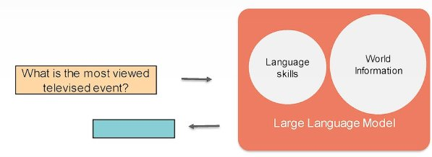
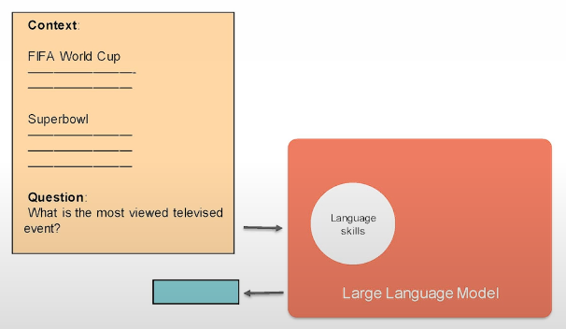
Why LLMs Need Context
Large Language Models:
Store broad world knowledge
Generate fluent responses
May hallucinate or lack domain grounding
Problem
Direct question → Model relies only on internal knowledge
Solution
Add a retrieval step before generation:
Search relevant passages
Inject them into the prompt
Generate answer grounded in retrieved text
Result
More factual answers
Domain-specific grounding
Reduced hallucinations
Notes:
Welcome to Lesson 4. I am very excited to show you one of my favorite methods called **Rerank**.
Now that you've learned keyword search and dense retrieval, Rerank is a way to improve them both. It is actually the second component of semantic search, in addition to dense retrieval.
Rerank allows a large language model to sort search results from best to worst based on how relevant they are to a given query.
---
### Rerank in Action
We begin by performing a search using Dense Retrieval, as learned in the previous lesson.
For example, consider the query:
**“What is the capital of Canada?”**
Dense retrieval may return:
* Ottawa (correct)
* Toronto
* Quebec City
Why does this happen?
Dense retrieval retrieves the most semantically similar sentences to the query. However, similarity does not always mean correctness. A sentence may be very close in meaning but still not answer the question correctly.
For example, possible responses could include:
* The capital of Canada is Ottawa. (Correct)
* Toronto is in Canada. (True but irrelevant)
* The capital of France is Paris. (True but wrong country)
* The capital of Canada is Sydney. (False)
* The capital of Ontario is Toronto. (True but wrong level)
Dense retrieval selects the sentences that are closest in embedding space. But the closest one might not be the correct answer.
This is where **Rerank** comes into play.
---
### What Rerank Does
Rerank takes:
* A query
* A set of candidate responses (from keyword search or dense retrieval)
It assigns a **relevance score** to each query-response pair.
The response with the highest relevance score is considered the best match.
For example:
* “The capital of Canada is Ottawa.” → Relevance: 0.90
* Other candidates → Lower scores
Rerank is trained using:
* Positive query-response pairs (correct matches)
* Negative query-response pairs (incorrect matches)
It learns to assign:
* High scores to correct matches
* Low scores to irrelevant or incorrect matches
---
### Improving Keyword Search with Rerank
Keyword search may retrieve many documents that contain similar words but do not answer the question.
If we retrieve many keyword results (for example, 500 documents), Rerank can:
* Evaluate each document
* Score them by relevance
* Select the top-ranked answers
This allows us to recover the correct answer even when keyword search alone fails.
---
### Improving Dense Retrieval with Rerank
Consider the query:
**“Who is the tallest person in history?”**
Dense retrieval may already retrieve relevant documents (e.g., Robert Wadlow).
But Rerank can:
* Score the candidates
* Ensure the most correct and precise answer appears at the top
For example:
* Robert Wadlow → Relevance: 0.97
* Other related articles → Lower scores
Rerank refines and improves the output of dense retrieval.
---
### Evaluating Search Systems
Search systems can be evaluated using metrics such as:
* **Mean Average Precision (MAP)**
* **Mean Reciprocal Rank (MRR)**
* **Normalized Discounted Cumulative Gain (NDCG)**
To evaluate:
* Create a test set with queries and correct answers
* Compare system outputs to ground truth
* Compute ranking-based metrics
---
### What’s Next?
Now that you know how to:
* Retrieve documents (keyword search + dense retrieval)
* Improve ranking with Rerank
The next step is to combine:
* A search system
* A generation model
This allows the system to generate natural language answers, like a human would.
---

Slide 19
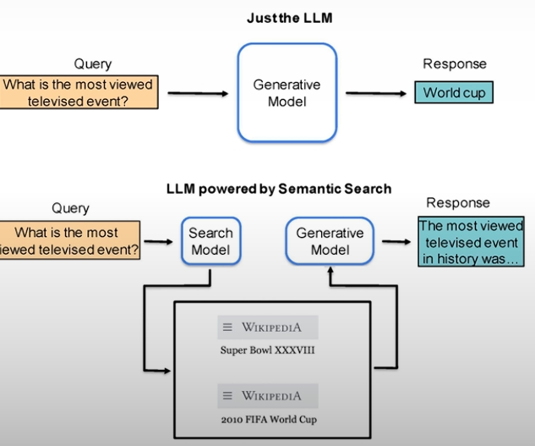
Retrieval-Augmented Generation (RAG) Flow
🔁 Two-Step Process
1️⃣ Retrieval
Embed query
Search semantic index
Retrieve relevant passages
2️⃣ Generation
Provide retrieved context + question
LLM extracts or synthesizes answer
Key Insight
Generation is now context-informed, not purely generative.
Notes:
Welcome to Lesson 4. I am very excited to show you one of my favorite methods called **Rerank**.
Now that you've learned keyword search and dense retrieval, Rerank is a way to improve them both. It is actually the second component of semantic search, in addition to dense retrieval.
Rerank allows a large language model to sort search results from best to worst based on how relevant they are to a given query.
---
### Rerank in Action
We begin by performing a search using Dense Retrieval, as learned in the previous lesson.
For example, consider the query:
**“What is the capital of Canada?”**
Dense retrieval may return:
* Ottawa (correct)
* Toronto
* Quebec City
Why does this happen?
Dense retrieval retrieves the most semantically similar sentences to the query. However, similarity does not always mean correctness. A sentence may be very close in meaning but still not answer the question correctly.
For example, possible responses could include:
* The capital of Canada is Ottawa. (Correct)
* Toronto is in Canada. (True but irrelevant)
* The capital of France is Paris. (True but wrong country)
* The capital of Canada is Sydney. (False)
* The capital of Ontario is Toronto. (True but wrong level)
Dense retrieval selects the sentences that are closest in embedding space. But the closest one might not be the correct answer.
This is where **Rerank** comes into play.
---
### What Rerank Does
Rerank takes:
* A query
* A set of candidate responses (from keyword search or dense retrieval)
It assigns a **relevance score** to each query-response pair.
The response with the highest relevance score is considered the best match.
For example:
* “The capital of Canada is Ottawa.” → Relevance: 0.90
* Other candidates → Lower scores
Rerank is trained using:
* Positive query-response pairs (correct matches)
* Negative query-response pairs (incorrect matches)
It learns to assign:
* High scores to correct matches
* Low scores to irrelevant or incorrect matches
---
### Improving Keyword Search with Rerank
Keyword search may retrieve many documents that contain similar words but do not answer the question.
If we retrieve many keyword results (for example, 500 documents), Rerank can:
* Evaluate each document
* Score them by relevance
* Select the top-ranked answers
This allows us to recover the correct answer even when keyword search alone fails.
---
### Improving Dense Retrieval with Rerank
Consider the query:
**“Who is the tallest person in history?”**
Dense retrieval may already retrieve relevant documents (e.g., Robert Wadlow).
But Rerank can:
* Score the candidates
* Ensure the most correct and precise answer appears at the top
For example:
* Robert Wadlow → Relevance: 0.97
* Other related articles → Lower scores
Rerank refines and improves the output of dense retrieval.
---
### Evaluating Search Systems
Search systems can be evaluated using metrics such as:
* **Mean Average Precision (MAP)**
* **Mean Reciprocal Rank (MRR)**
* **Normalized Discounted Cumulative Gain (NDCG)**
To evaluate:
* Create a test set with queries and correct answers
* Compare system outputs to ground truth
* Compute ranking-based metrics
---
### What’s Next?
Now that you know how to:
* Retrieve documents (keyword search + dense retrieval)
* Improve ranking with Rerank
The next step is to combine:
* A search system
* A generation model
This allows the system to generate natural language answers, like a human would.
---

Slide 20
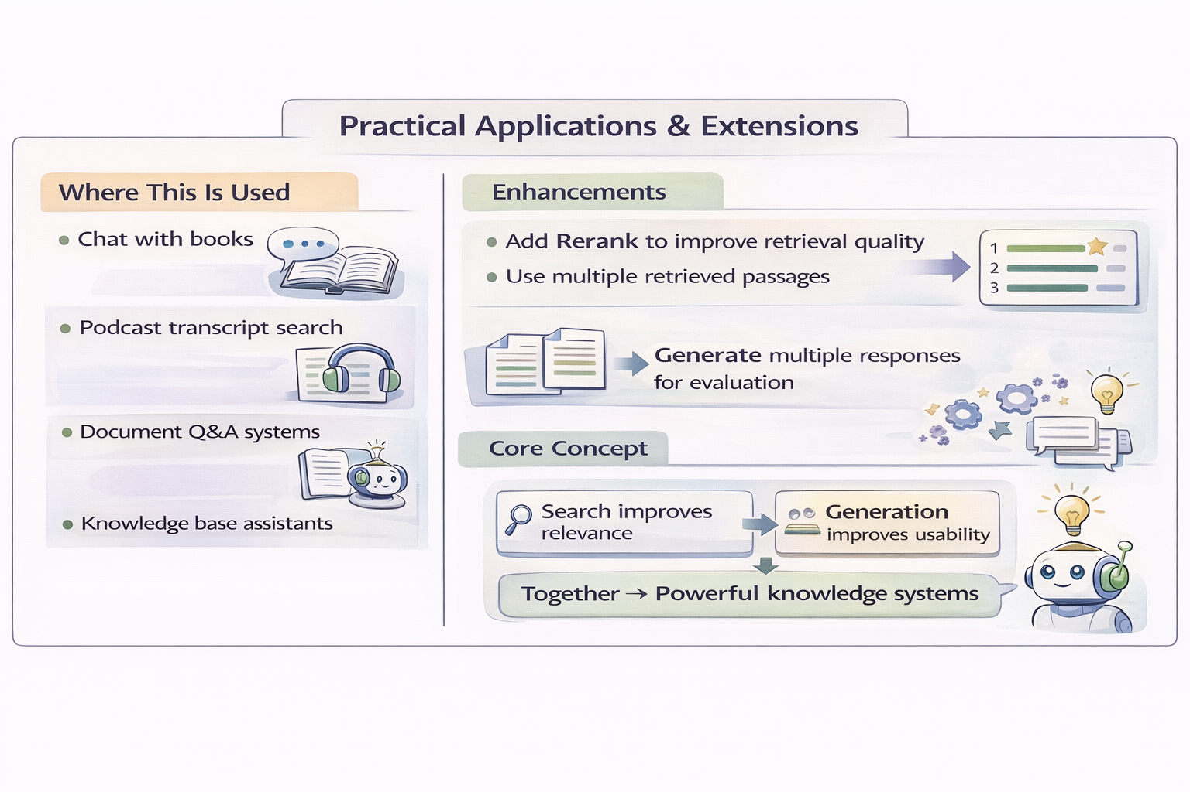
Practical Applications & Extensions
Where This Is Used
Chat with books
Podcast transcript search
Document Q&A systems
Knowledge base assistants
Enhancements
Add Rerank to improve retrieval quality
Use multiple retrieved passages
Generate multiple responses for evaluation
Core Concept
Search improves relevance. Generation improves usability. Together → Powerful knowledge systems.
Notes:
Welcome to Lesson 4. I am very excited to show you one of my favorite methods called **Rerank**.
Now that you've learned keyword search and dense retrieval, Rerank is a way to improve them both. It is actually the second component of semantic search, in addition to dense retrieval.
Rerank allows a large language model to sort search results from best to worst based on how relevant they are to a given query.
---
### Rerank in Action
We begin by performing a search using Dense Retrieval, as learned in the previous lesson.
For example, consider the query:
**“What is the capital of Canada?”**
Dense retrieval may return:
* Ottawa (correct)
* Toronto
* Quebec City
Why does this happen?
Dense retrieval retrieves the most semantically similar sentences to the query. However, similarity does not always mean correctness. A sentence may be very close in meaning but still not answer the question correctly.
For example, possible responses could include:
* The capital of Canada is Ottawa. (Correct)
* Toronto is in Canada. (True but irrelevant)
* The capital of France is Paris. (True but wrong country)
* The capital of Canada is Sydney. (False)
* The capital of Ontario is Toronto. (True but wrong level)
Dense retrieval selects the sentences that are closest in embedding space. But the closest one might not be the correct answer.
This is where **Rerank** comes into play.
---
### What Rerank Does
Rerank takes:
* A query
* A set of candidate responses (from keyword search or dense retrieval)
It assigns a **relevance score** to each query-response pair.
The response with the highest relevance score is considered the best match.
For example:
* “The capital of Canada is Ottawa.” → Relevance: 0.90
* Other candidates → Lower scores
Rerank is trained using:
* Positive query-response pairs (correct matches)
* Negative query-response pairs (incorrect matches)
It learns to assign:
* High scores to correct matches
* Low scores to irrelevant or incorrect matches
---
### Improving Keyword Search with Rerank
Keyword search may retrieve many documents that contain similar words but do not answer the question.
If we retrieve many keyword results (for example, 500 documents), Rerank can:
* Evaluate each document
* Score them by relevance
* Select the top-ranked answers
This allows us to recover the correct answer even when keyword search alone fails.
---
### Improving Dense Retrieval with Rerank
Consider the query:
**“Who is the tallest person in history?”**
Dense retrieval may already retrieve relevant documents (e.g., Robert Wadlow).
But Rerank can:
* Score the candidates
* Ensure the most correct and precise answer appears at the top
For example:
* Robert Wadlow → Relevance: 0.97
* Other related articles → Lower scores
Rerank refines and improves the output of dense retrieval.
---
### Evaluating Search Systems
Search systems can be evaluated using metrics such as:
* **Mean Average Precision (MAP)**
* **Mean Reciprocal Rank (MRR)**
* **Normalized Discounted Cumulative Gain (NDCG)**
To evaluate:
* Create a test set with queries and correct answers
* Compare system outputs to ground truth
* Compute ranking-based metrics
---
### What’s Next?
Now that you know how to:
* Retrieve documents (keyword search + dense retrieval)
* Improve ranking with Rerank
The next step is to combine:
* A search system
* A generation model
This allows the system to generate natural language answers, like a human would.
---

Slide 21
Thank you for the attention
Fabio Antonini
Software Engineer
Fabio.antonini.1969@gmail.com

